Slide 1

Data Structures in Python

Slide 2

Agenda
Introduction to String Matching
KMP Algorithm
Rabin–Karp Algorithm
Z Algorithm
Comparison of String Algorithms
Practice examples and applications

Slide 3
Unit Overview
This unit introduces String Algorithms used for efficient pattern searching in text. Students will learn advanced algorithms like KMP (Knuth–Morris–Pratt), Rabin–Karp, and Z Algorithm, which help find patterns quickly without checking every character repeatedly.
These algorithms are widely used in applications like text editors, search engines, plagiarism detection, and data processing.

Slide 4
Introduction to String Algorithms
String algorithms are used to search, match, and analyze patterns in text efficiently.
Problem:
Given:
Text = "ABABDABACDABABCABAB"
Pattern = "ABABCABAB"
Find pattern position in text.

Slide 5
Introduction to String Algorithms
Applications
Search engines (Google search)
Text editors (Find option)
Plagiarism detection
DNA sequence matching
Data compression

Slide 6
Introduction to String Algorithms
Basic Method (Naive Approach)
Check pattern at every position.
Example:
Text: "ABCABCABC"
Pattern: "ABC"
Check at index 0, 1, 2, ...
Time Complexity:
O(n × m)
Slow for large text.

Slide 7
KMP Algorithm (Knuth–Morris–Pratt)
KMP avoids unnecessary comparisons using LPS array (Longest Prefix Suffix).
It uses previously matched information.
What is LPS Array?
LPS stores length of longest prefix which is also suffix.
Example:
Pattern = "ABABCABAB"
LPS:
Pattern: A B A B C A B A B
Index: 0 1 2 3 4 5 6 7 8
LPS: 0 0 1 2 0 1 2 3 4

Slide 8
KMP Algorithm (Knuth–Morris–Pratt)
Steps in KMP
Step 1: Build LPS array
Step 2: Compare pattern with text
Step 3: Shift pattern using LPS

Slide 9
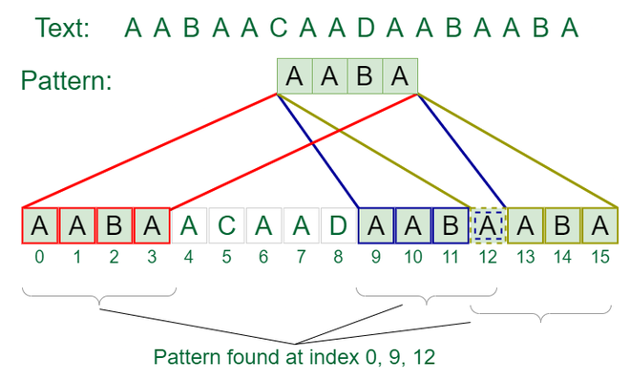
KMP Algorithm (Knuth–Morris–Pratt)

Slide 10
Rabin–Karp Algorithm
Uses hash function to compare pattern and text.
Instead of comparing characters, compare hash values.
Steps
Step 1: Calculate hash of pattern
Step 2: Calculate hash of text window
Step 3: Compare hashes
Step 4: Slide window
Example
Text: "ABCABCABC"
Pattern: "ABC"
Compare hash values.

Slide 11
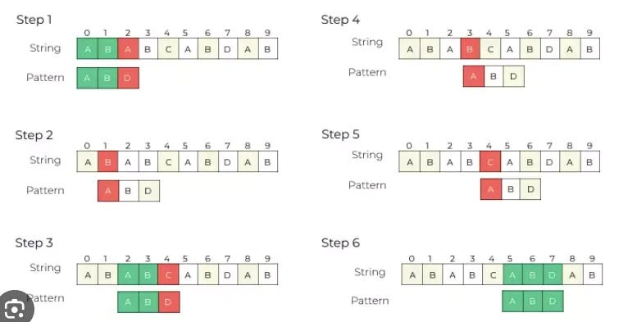
Rabin–Karp Algorithm

Slide 12
Z Algorithm
Creates Z array which stores length of substring matching prefix.
Example
String:
ABABCABAB
Z array:
[0,0,2,0,0,4,0,2,0]
Use in Pattern Matching
Combine:
pattern + "$" + text
Example:
ABC$ABCABCABC

Slide 13
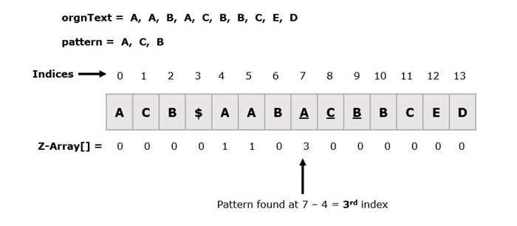
Z Algorithm

Slide 14
Pattern Search using Z Algorithm
def z_search(text, pattern):
string = pattern + "$" + text
z = z_algorithm(string)
for i in range(len(z)):
if z[i] == len(pattern):
print("Pattern found at index", i-len(pattern)-1)
z_search("ABCABCABC", "ABC")
Output:
Pattern found at index 0
Pattern found at index 3
Pattern found at index 6

Slide 15
Real-World Applications
Used in:
Search engines
Text editors
DNA matching
Spam detection
Data mining

Slide 16
Example Practice Problem
Text:
AABAACAADAABAABA
Pattern:
AABA
Output:
Index 0
Index 9
Index 12

Slide 17
Key Outcomes
      Understand string pattern matching concepts
      Implement KMP algorithm
      Implement Rabin–Karp algorithm
      Implement Z algorithm
      Compare different string searching techniques
      Apply string algorithms in real-world problems

Slide 18
Thank You!

